Slide 1



The Kindred Supply : A Strategic Sales and Revenue Analysis
A complete overview of sale and revenue’s ins and outs
-by Saniya Sayyad

Slide 2
About Project
This report aims to provide a comprehensive view of the company’s operations by consolidating data from multiple tables. It will analyze sales performance, customer segmentation, inventory trends, and employee productivity to uncover key insights into customer behavior, sales patterns, and workforce efficiency.

Slide 3

The Kindred Supply ,USA We are among your family
“The Kindred supply is a global wholesaler supply chain with headquarters in USA ,having specialty in foods and beverages. With an international customer base and diverse suppliers.
We have up to 8 different food categories and 77 different products ,16 different suppliers , large number of multitasking representative staff handling all over turnover and wide customer range with day on day growth in its family, infrastructure ,production“

Slide 4
We have 8 CSV files
Customers-This table stores information about the company's customers and their basic information.
Orders-This table stores information about the Customer’s orders. It includes order ID, customer ID, employee ID, order date, shipped date,shipping address etc
Orderdetails-This table stores detailed information about the items within each order.
Suppliers-This table stores information about the suppliers ,their names ,ids, adress
Categories-This table stores information about the product categories. fields for category ID, category name
Shippers-This table stores information about different shipping companies
Products-This table stores information about the company's products and their details
Employees-This table stores information about the company's employees and their details

Slide 5
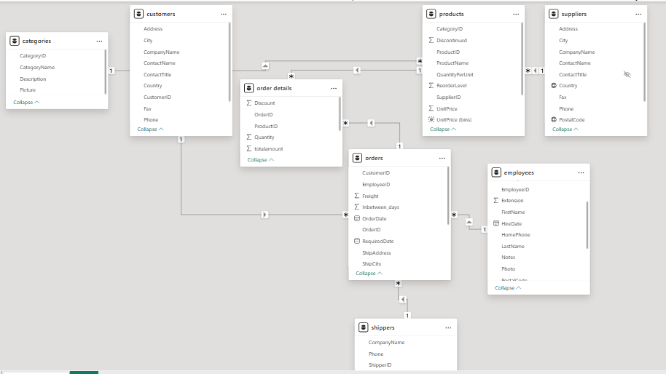
ER diagram

Slide 6
Step by step procedure for sales_analysis
Step1-Data cleaning
Step2-Data analysis in MYSQL
Step3-EDA in excel
Step4-EDA in power bi

Slide 7
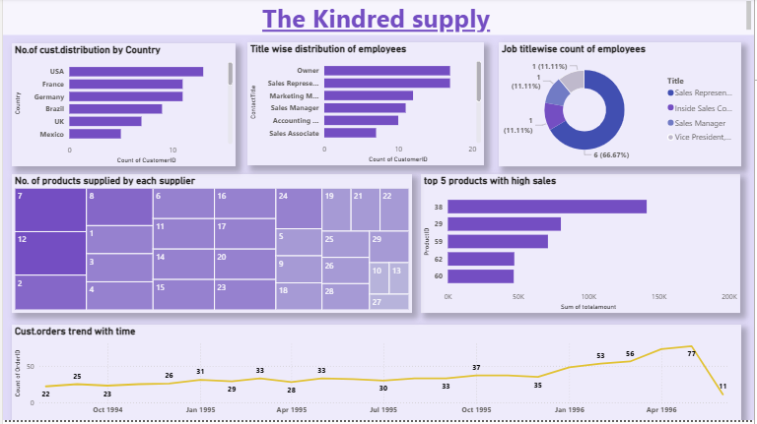
Sales analysis dashboard 1

Slide 8
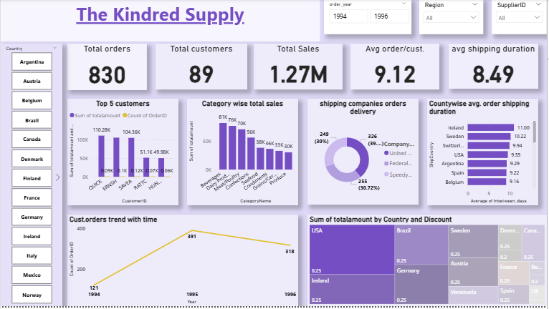
Sales analysis dashboard 2

Slide 9
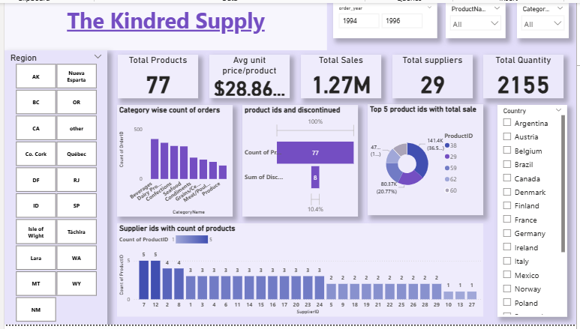
Sales analysis dashboard 3

Slide 10
Key Findings-
Sales Performance: Certain countries like USA and product categories like Beverages are consistently higher drive for sales
Customer Behavior: A small group of loyal customers with customer id-QUICK,SAVEA,FRNSH contributes significantly to overall raise revenue.
Employee performance –Employees with ids-1,3,4,8 have contributed well to higher order count.
Yearly performance-Considering all 3 years 1994 has 121 order count,1995 has 391 order count,1996 has 318 order count
Uncovered Till now-
total orders-830
Total sale-1.2 ML
Avg order/cust-9
Avg shipping duration-8days
Avg price/product=$28.8
Total customers-89

Slide 11
suggestions to improve Overall sale-
giveaways -discounts ,offers should be given to customers in the region/country which has less sale
Campaigning –should be done to inform customers about various products and categories
Employee Productivity: Should provide training or incentive programs.
Inventory Trends: optimized stock management is needed according to requirements of products
Shipping duration-avg. shipping duration is 8 days ,which should minimized

Slide 12
Conclusion
The Kindred supply: A Strategic Sales and revenue Analysis project has successfully integrated and analyzed data from multiple sources to generate meaningful business insights. Through structured data cleaning and transformation ,Manipulation inconsistencies were resolved, and relationships across datasets were established.
Analysis revealed key sales trends, customer purchase patterns, and product performance indicators. Through Power bi visualization , interactive and dynamic dashboards will allow stakeholder to explore sales by region, products, categories , time periods

